Slide 1
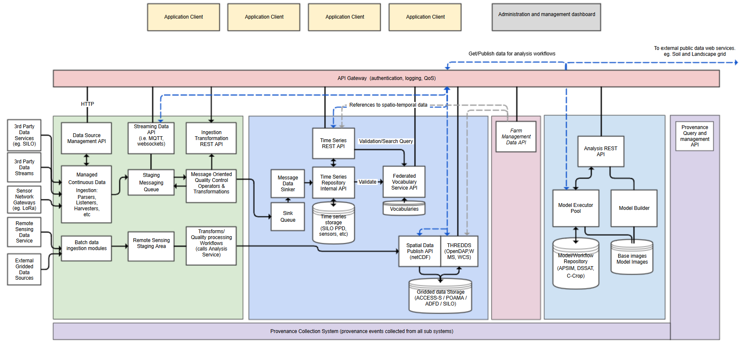
Species of Digiscape Datasets
PROV-O Classes
Output Datasets
Entity
Activity
Data from APIs
Agent
Software Code
Config Files
Conflux architecture
Source Datasets
Internal Datasets
Reference Metadata Datasets

Slide 2
Entity Notes
Not all “Datasets” are chunks of files: they could be expressions of Web Service calls, i.e. web logs of requests against Digiscape APIs
There can be any level of specialisation within the Source, Output etc. Entity types presented here for particular purposes

Slide 3
Species of Digiscape Activities
PROV-O Classes
Entity
API Transformations
Activity
Agent
Conflux architecture
Source Dataset Preparation
Internal Dataset Processing
Model Execution

Slide 4
Activity Notes
Activities may not need to be typed as type may be unimportant or inferred
Inferring type: an instance of an Activity could be recorded and the Agent that enacted it, e.g. a “Run Model” Activity by Agent Model X
A prov:Plan object of a particular type, e.g. a particular Software Code, may be consumed by an un-typed Activity indicating what process was run

Slide 5
Species of Digiscape Agents
PROV-O Classes
Digiscape Systems
Digiscape People
Entity
Activity
Agent
Conflux architecture

Slide 6
Agent Notes
All Digiscape systems and people are interpreted as Agents
Specialised Agents, ReportingSystems, can report provenance to PROMS

Slide 7
Digiscape prov. model use by PROMS
This Digiscape provenance model can be implemented as an Ontology
PROMS implements hierarchical validation for all Reports of provenance sent to it, therefore all Reports must be:
PROV-O valid
PROMS-O valid (e.g. the sender of a Report is a Reportingsystem)
Digiscape could implement a provenance model that then can be used for validation of Digiscape Reports so PROMS would implement “Digiscape-O valid” after PROV-O & PROMS-O valid tests
Further specialised validators can be used, e.g. for Digiscape Carbon Farming Reports

Slide 8
PROV-O Classes
PROMS Reporting System
Entity
dcat: Dataset
Activity
DigiScape Dataset
Agent
DigiScape Reporting System
Source Dataset
Internal Dataset
DigiScape Product
rdfs:subClassOf

